Slide 1
Integrating New Windows 10 & WinRT Platform Features Into Your App
Jim McKeeth, Embarcadero Technologies

Slide 2
Introducing Microsoft Windows 10
New version of Microsoft’s OS
Free upgrade for Windows Vista and newer users
Now running on > 110 million devices
Combines best of Windows 7 and 8.1
Making native Win32/Win64 applications 1st class again
Notes:
Everyone is moving to Windows 10. It is important that developers apps support it appropriately.

Slide 3
New 10 Seattle Features for Windows 10
Features for VCL, FMX or Any Windows 10 App

Slide 4
New Windows 10 Related Features
RTL
WinRT API Interface
TNotificationCenter everywhere
Contracts (contract source)
Windows 10 SDK
FMX
New MultiView Behavior
New TSwitch Behavior
Native controls
Windows 10 FMX Style
VCL
High-DPI & 4K monitor support
TActivityIndicator
TSearchBox
TRelativePanel
ToggleSwitch
SplitView
Windows 10 VCL Style
Notes:
Windows 10 SDK installed with the IDE

Slide 5
So What Exactly is the Windows Runtime (WinRT)?
First a history lesson

Slide 6
Windows API Timeline
Every attempt was made at accuracy,
but this timeline is by no means complete.
Viewers who are sticklers for accuracy
are invited to present at CodeRage next year.

Slide 7
Windows API Timeline
Windows NT 3.1
Win32
Interaction
VCL
& RTL
1993

Slide 8
Windows API Timeline
Windows NT 3.1
Windows XP
Win32
.NET
VCL
& RTL
1993
2002

Slide 9
Windows API Timeline
Windows NT 3.1
Windows XP
Windows Vista
Win32
Forecast
.NET
Interaction
VCL
.NET
VCL
& RTL
1993
2002
2007

Slide 10
Windows API Timeline
Windows NT 3.1
Windows XP
Windows Vista
Win32
.NET
Reality
VCL
.NET
VCL
& RTL
1993
2002
2007

Slide 11
Windows API Timeline
Windows NT 3.1
Windows XP
Windows Vista
Win32
.NET
VCL
& RTL
FMX
1993
2002
2007
2012
2015

Slide 12
Windows API Timeline
Windows NT 3.1
Windows XP
Windows Vista
Windows 8
Win32
.NET
Interaction
WinRT
VCL
& RTL
FMX
1993
2002
2007
2012
2015

Slide 13
Windows API Timeline
Windows NT 3.1
Windows XP
Windows Vista
Windows 8
Windows 10
Win32
Interaction
.NET
Interaction
WinRT
Interaction
VCL
& RTL
FMX
1993
2002
2007
2012
2015

Slide 14
What is Windows Runtime (WinRT)?
Not to be confused
with the retired
Windows RT tablet OS
Introduced in Windows 8
Default application programming interface
Does not replace Win32 API (at the same level)
Windows 10 allows much more WinRT access from Win32 applications than Windows 8.1
Notes:
Not .NET
Native code
Focused on performance
Not to be confused with the ARM tablet version of Windows.

Slide 15
Windows Runtime continued
An object-oriented API
Asynchronous (no blocking > 50 ms)
COM based (but different)
Not .NET, not managed code
A Native Code API

Slide 16
The RTL Windows Runtime Interface
Helpers ease creation of objects
Abstracts dealing with the class factories
Over 40 new WinApi.* units
New TWindowsString for new HString type
Much less code required to interface with WinRT than with C# or MSVC++
Notes:
Less code is required with Delphi and C++Builder than Microsoft’s C# and VC++

Slide 17
Windows Runtime API Interfaces (Mostly found in source\rtl\win\winrt folder)
WinAPI.ApplicationModel.Background
WinAPI.ApplicationModel.Core
WinAPI.ApplicationModel.DataTransfer
WinAPI.ApplicationModel
WinAPI.CommonTypes
WinAPI.DataRT
WinAPI.Devices.Bluetooth
WinAPI.Devices.Enumeration
WinAPI.Devices
WinAPI.Foundation.Collections
WinAPI.Foundation
WinAPI.Foundation.Types
WinAPI.Gaming
WinAPI.Globalization
WinAPI.GraphicsRT
WinAPI.Management
WinAPI.Media
WinAPI.Networking.Connectivity
WinAPI.Networking.NetworkOperators
WinAPI.Networking
WinAPI.Networking.Proximity
WinAPI.Networking.Sockets
WinAPI.Networking.Vpn
WinAPI.Security.Credentials
WinAPI.Security.Cryptography
WinAPI.Security
WinAPI.Storage
WinAPI.Storage.Streams
WinAPI.SystemRT
WinAPI.UI.Composition
WinAPI.UI.Core
WinAPI.UI.Input.Inking
WinAPI.UI.Input
WinAPI.UI.Notifications
WinAPI.UI
WinAPI.UI.Text
WinAPI.UI.ViewManagement
WinAPI.UI.WebUI
WinAPI.UI.Xaml
WinAPI.WebRT
System.Win.WinRT
Notes:
Some of the new WinRT units
Unlocks 100s of new Windows 10 features via WinRT. Windows 10 is making native apps first class citizens.

Slide 18
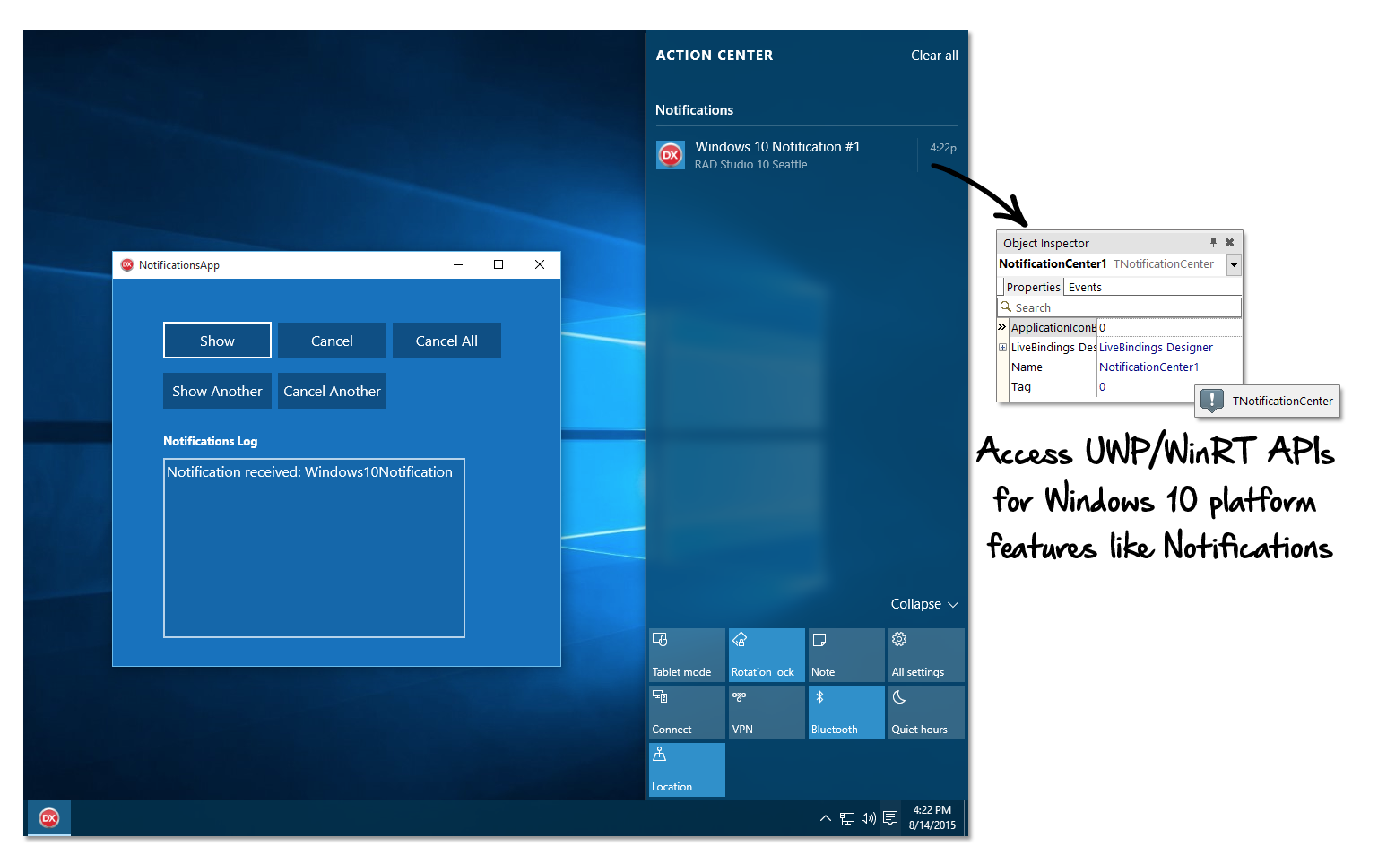
New Notifications in Windows 10

Slide 19
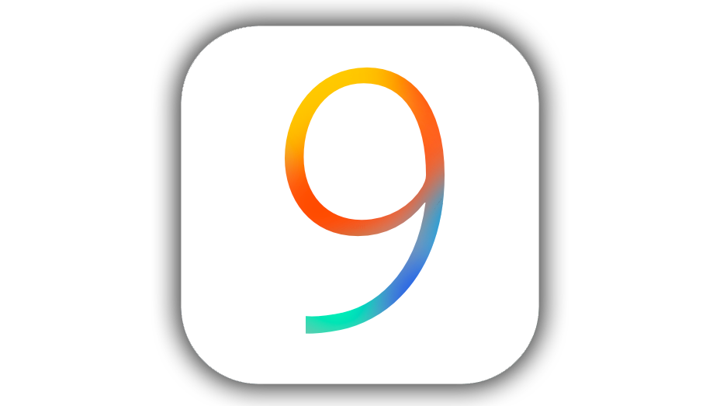
Notifications via TNotificationCenter
Immediate or Scheduled notifications
Even after app closes
Custom alert body message
Re-launches app
Works across all platforms
Appears in the new Action Center on Windows 10
Apple OS X
Apple

Slide 20
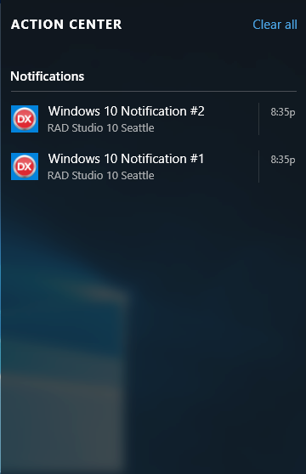
Windows 10 Notifications
Moved to System.Notifications
Works with VCL, RTL and all app types
Start menu shortcut required to relaunch app
Notes:
C:\Users\Public\Documents\Embarcadero\Studio\17.0\Samples\Object Pascal\VCL\Windows 10 Notifications
Or
C:\Users\Public\Documents\Embarcadero\Studio\17.0\Samples\CPP\VCL\Windows 10 Notifications
System.Win.Notifications includes a TNotificationCenterWinRT.CerateShortcut
In Windows 10 go to Settings / System / Notifications to see what apps that can display notifications.

Slide 21

Share Contract on Windows 10
Share content to other apps
Act as a source
Share text, images, links, etc.
Share to email or other apps
Include meta information: titles, body and attachments
TSharingContract (VCL) or TShareContract (RTL)

Slide 22
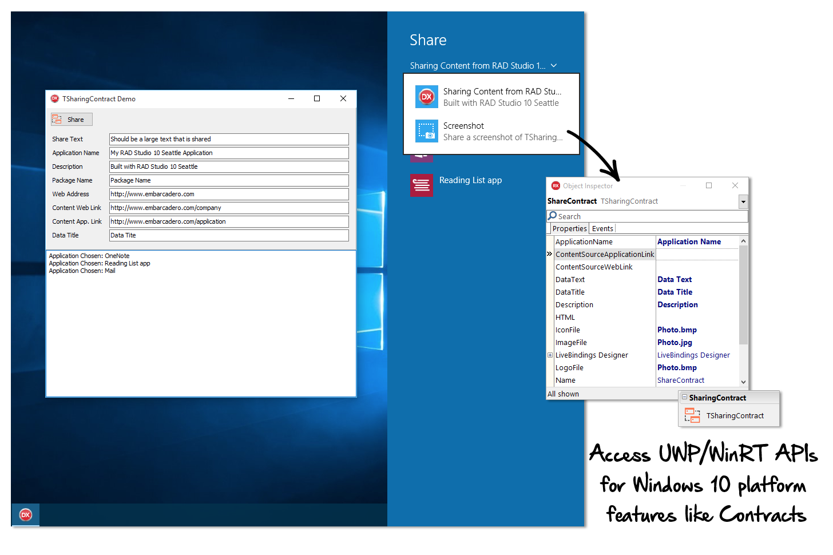
Share Contract on Windows 10

Slide 23
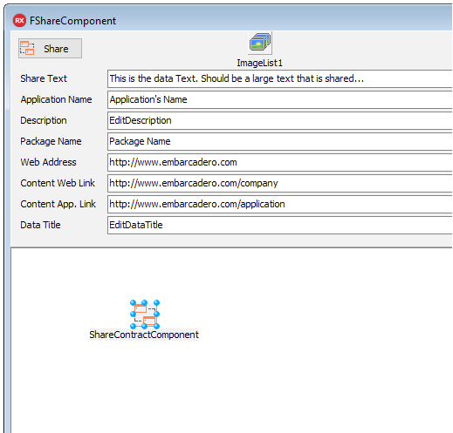
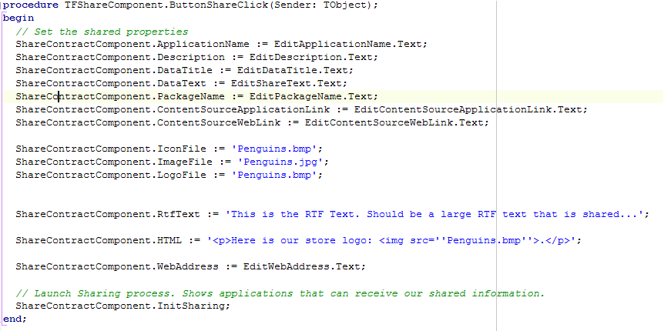
Share Contract Example
Notes:
C:\Users\Public\Documents\Embarcadero\Studio\17.0\Samples\Object Pascal\VCL\Windows 10 SharingContract
Or
C:\Users\Public\Documents\Embarcadero\Studio\17.0\Samples\CPP\VCL\Windows 10 SharingContract

Slide 24
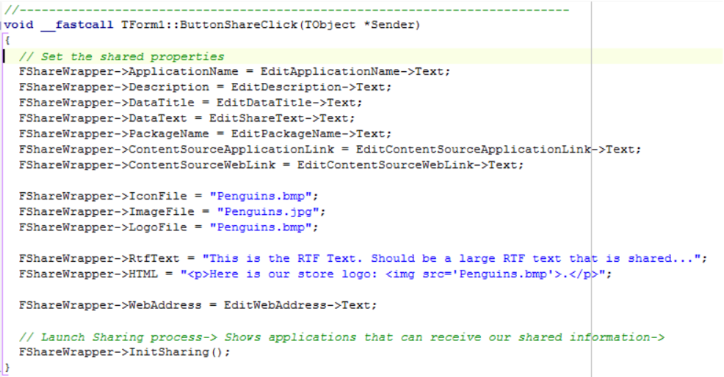
Share Contract Example
Notes:
C:\Users\Public\Documents\Embarcadero\Studio\17.0\Samples\Object Pascal\VCL\Windows 10 SharingContract
Or
C:\Users\Public\Documents\Embarcadero\Studio\17.0\Samples\CPP\VCL\Windows 10 SharingContract

Slide 25
Low Level WinRT Calls
Referenced by Interface for automatic reference counting
Helpers like TWindowsString in System.Win.WinRT
Many classes have default parameterless constructors
Use .Factory to access other constructors
Use .Statics to access static members of class

Slide 26
Windows 10 Visual Components
FMX and VCL

Slide 27
New FMX MultiView Behavior
Navigation Panel
Visible expanded and collapsed
Available across all platforms
Platform Default for Windows 10

Slide 28
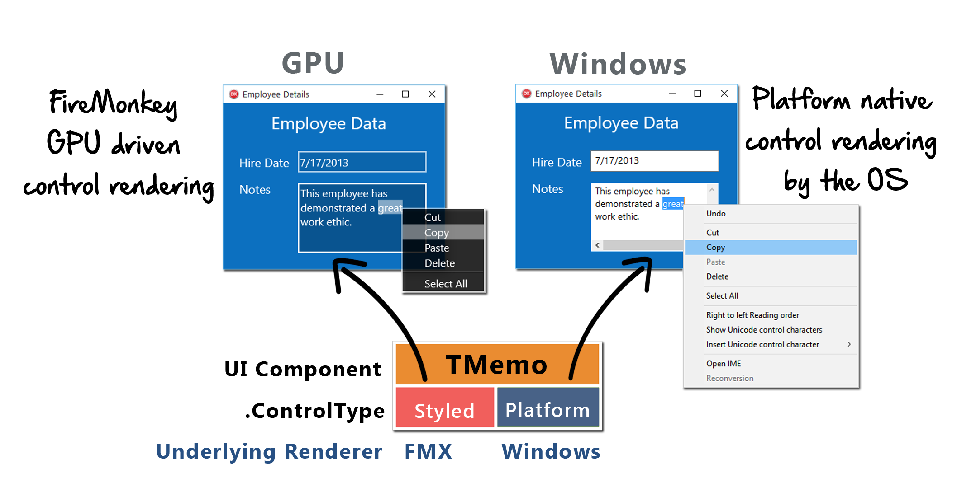
FireMonkey Platform Native Rendering Architecture
Currently available on iOS and Windows
Notes:
Set the control type from Styled to Platform

Slide 29
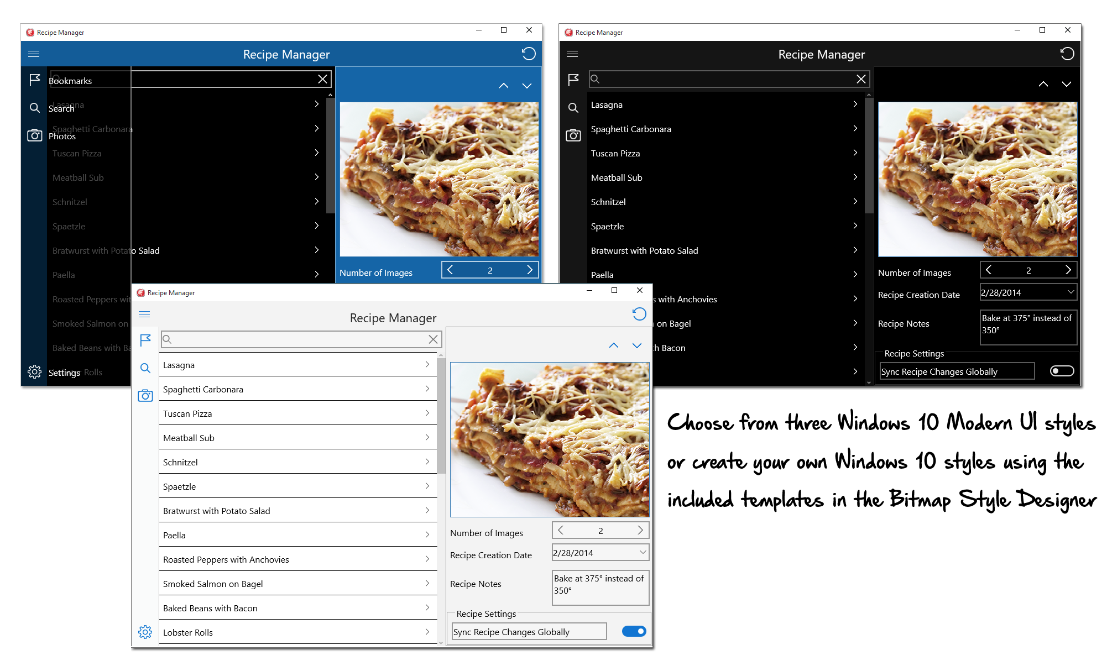
FireMonkey Windows 10 Styles

Slide 30
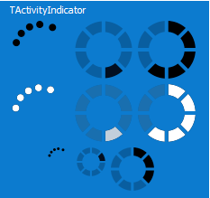
VCL Animated Activity Indicator
TActivityIndicator in Vcl.WinXCtrls
Similar to FMX TAniIndicator
Customizable
Three indicator types
Four sizes
Two colors
Adjustable frame delay
Notes:
C:\Users\Public\Documents\Embarcadero\Studio\17.0\Samples\Object Pascal\VCL\ActivityIndicator
Or
C:\Users\Public\Documents\Embarcadero\Studio\17.0\Samples\CPP\VCL\ActivityIndicator
http://docwiki.embarcadero.com/Libraries/Seattle/en/Vcl.WinXCtrls.TActivityIndicator

Slide 31
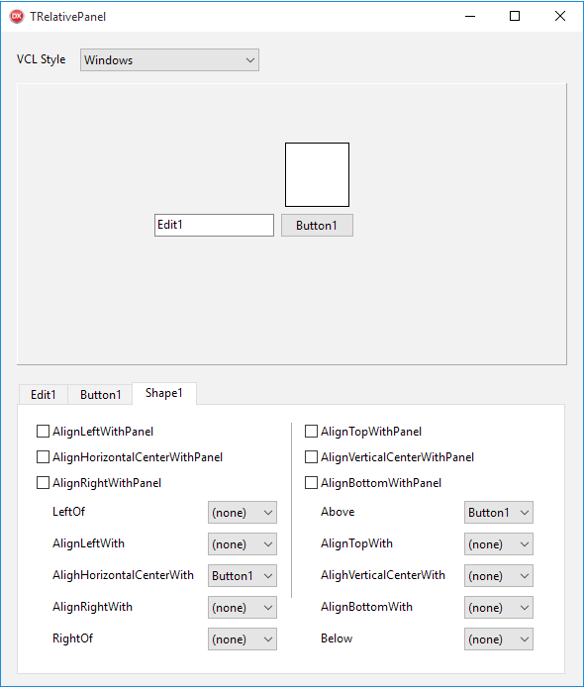
VCL Relative Layout Panel – TRelativePanel
Controls position based on relative position
Set position via ControlCollection
Find child control with IndexOf()
Or at design time use properties
Align[xx]WithPanel: Boolean
Above: [Sibling]
Align[xx]With: [Sibling]
LeftOf: [Sibling]
http://docwiki.embarcadero.com/RADStudio/en/Using_the_Relative_Panel
Notes:
C:\Users\Public\Documents\Embarcadero\Studio\17.0\Samples\Object Pascal\VCL\RelativePanel
Or
C:\Users\Public\Documents\Embarcadero\Studio\17.0\Samples\CPP\VCL\RelativePanel

Slide 32
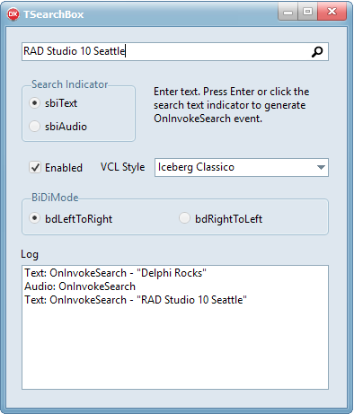
VCL SearchBox - TSearchBox
Includes search indicator
Text and Audio indicators
Has OnInvokeSearch event
Used to manually search or filter other controls
Notes:
C:\Users\Public\Documents\Embarcadero\Studio\17.0\Samples\Object Pascal\VCL\SearchBox
Or
C:\Users\Public\Documents\Embarcadero\Studio\17.0\Samples\CPP\VCL\SearchBox

Slide 33
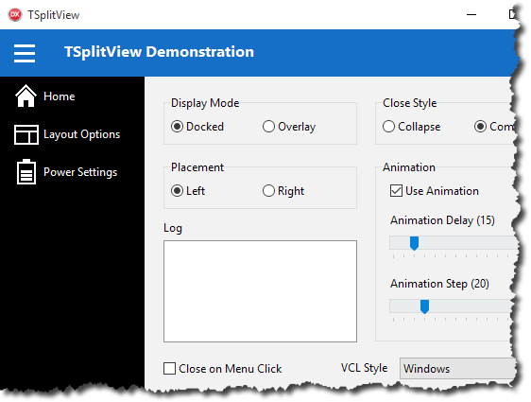
VCL Split View – TSplitView
Similar to FMX MultiView
Adjustable behaviors, placements and style
Can contain any other controls
Animated expand and collapse
TSplitView
Notes:
C:\Users\Public\Documents\Embarcadero\Studio\17.0\Samples\Object Pascal\VCL\SplitView
Or
C:\Users\Public\Documents\Embarcadero\Studio\17.0\Samples\CPP\VCL\SplitView

Slide 34
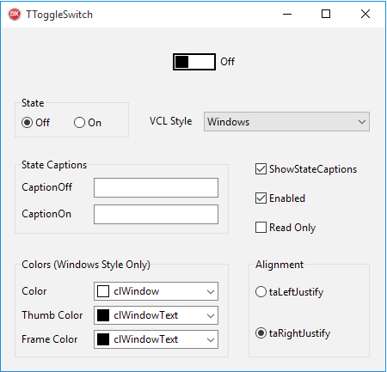
VCL Toggle Switch - TToggleSwitch
Similar to FMX TSwitch
Custom captions
Custom colors
Reizable elements
Disabled and Read-Only
Property State: tssOn or tssOff
Function IsOn: Boolean
Notes:
C:\Users\Public\Documents\Embarcadero\Studio\17.0\Samples\Object Pascal\VCL\ToggleSwitch
Or
C:\Users\Public\Documents\Embarcadero\Studio\17.0\Samples\CPP\VCL\ToggleSwitch

Slide 35
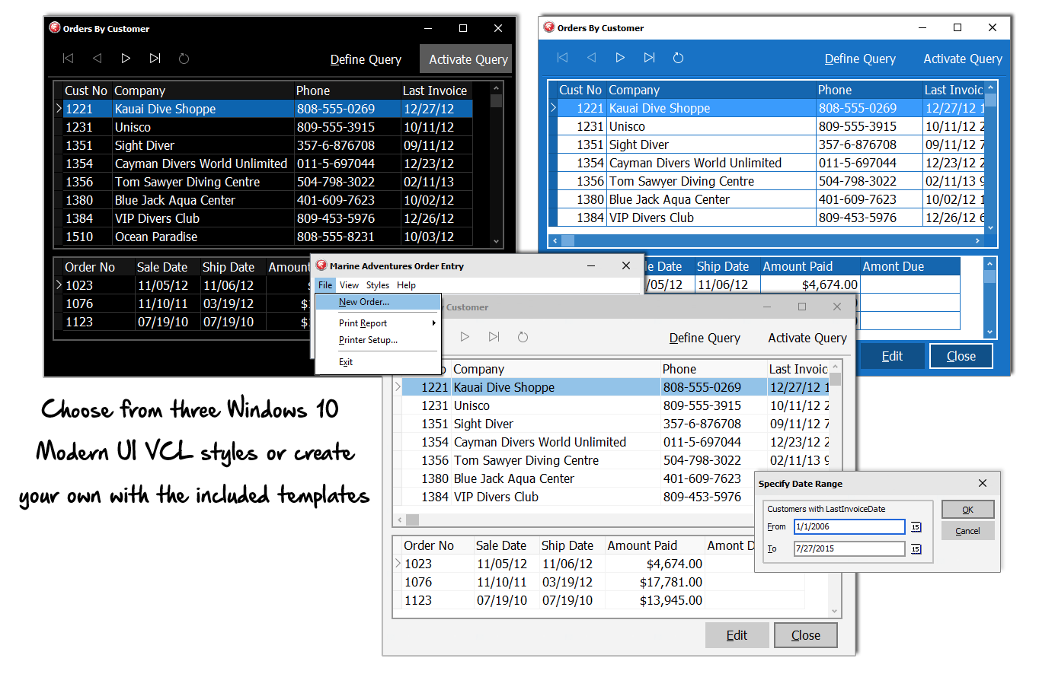
Windows 10 VCL Style

Slide 36
Universal Windows Platform (UWP)
The Project Centennial Bridge

Slide 37
Universal Windows Platform (UWP)
Windows Store distribution
Automatic updates, installs and uninstalls
Sandboxed safety
Full access to WinRT and platform features
Requires universal AppID

Slide 38
Project Centennial Bridge
Forthcoming Microsoft bridge for Native Win32 to UWP
Gives all advantages of UWP on the Windows 10 desktop to native apps, including universal AppID
Bundles app, files, registry, etc. in APPX
App runs without virtualization (IO mapped to bundle)
Expected is app cannot escalate to admin
Centennial Bridge by Cracker Ken https://commons.wikimedia.org/wiki/File:Centennial_Bridge.jpg

Slide 39
More on Centennial
Intro session from //build/ 2015
https://channel9.msdn.com/Events/Build/2015/2-692
Sign-Up for Updates
https://devpreviewsignup.windows.com/

Slide 40
Wait, what about Windows Phone?
The Project Astoria Bridge

Slide 41

Project Astoria Bridge
Windows Phone 10 includes Android subsystem
Bridges Android apps to Windows Phone 10
Android API calls map to Windows API calls
Runs many APKs without modification
Unlocks Windows Phone 10 specific features too
By aselfcallednowhere used under CC
https://commons.wikimedia.org/wiki/File:Astoria,_OR_from_the_Astoria_Column.jpg

Slide 42
More on Astoria
Intro session from //build/ 2015
https://channel9.msdn.com/Events/Build/2015/2-702
Sign-Up
http://aka.ms/projectastoria

Slide 43
Summary: VCL, FMX and Windows 10
Windows 10 is making Win32/Win64 first class again
VCL remains the best Windows client library
Now enhanced with Windows 10 UI controls and WinRT APIs and Components
FireMonkey desktop significantly enhanced
RAD Studio committed to keep focusing on the Windows 10 platform

